Slide 1
PHYSICAL AND
DEVICE MODELS
Chapter 12.5
Present By
Nahidul Islam - 2028
Md.Shakil Hossain - 2023
Mahbubur Rahman - 2024
Gpoup - 23
Page - 1

Slide 2

Physical and device model
It has two types:
1
2
Keystroke Level Model(KLM)
Three State Model
Gpoup - 23
Page - 2

Slide 3

Keystroke-Level Model (KLM)
The Keystroke-Level Model is a simplified version of GOMS. It was proposed by Card and Moran (1980) as a method for predicting user performance. Using KLM, execution time is estimated by listing the sequence operators and then summing the times of the individual operators. KLM aggregates all perceptual and cognitive function into a single value for an entire task, using a heuristic. KLM also does not employ selection rules. The original KLM had six classes of operators: K for pressing a key, P for pointing to a location on screen with the mouse, H for moving hands to home position on the keyboard, M for mentally preparing to perform an action, and R for system response where the user waits for the system. For each operator, there is an estimate of execution time. Additionally, there is a set of heuristic rules to account for mental preparation time.
Gpoup - 23
Page - 3

Slide 4
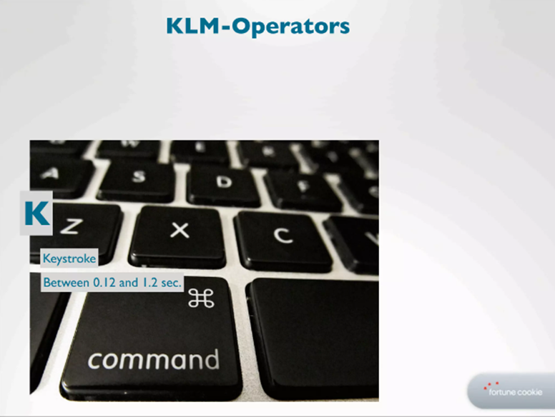
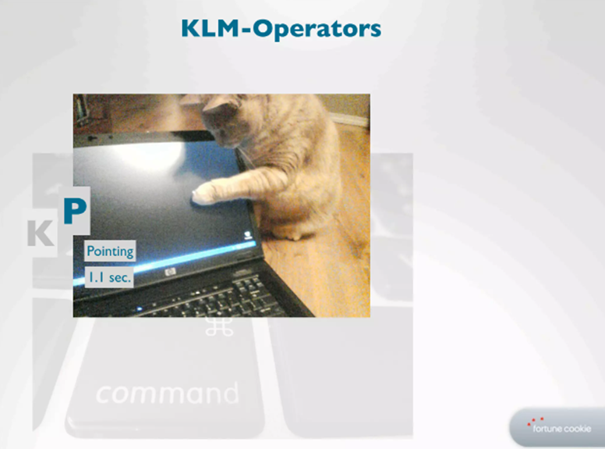
KLM Operator
Gpoup - 23
Page - 4

Slide 5
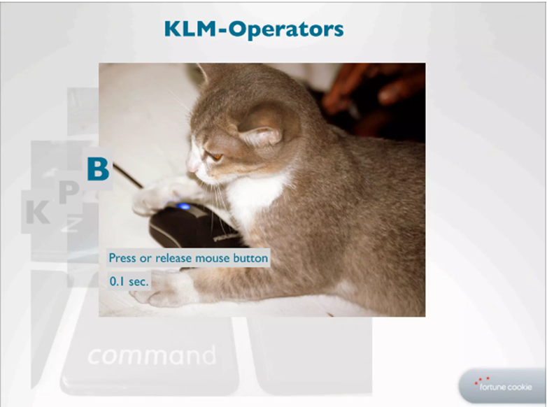
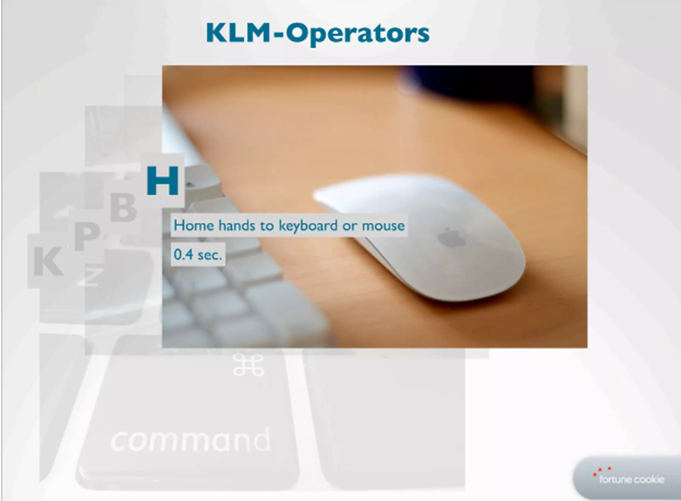
KLM Operator
Gpoup - 23
Page - 5

Slide 6
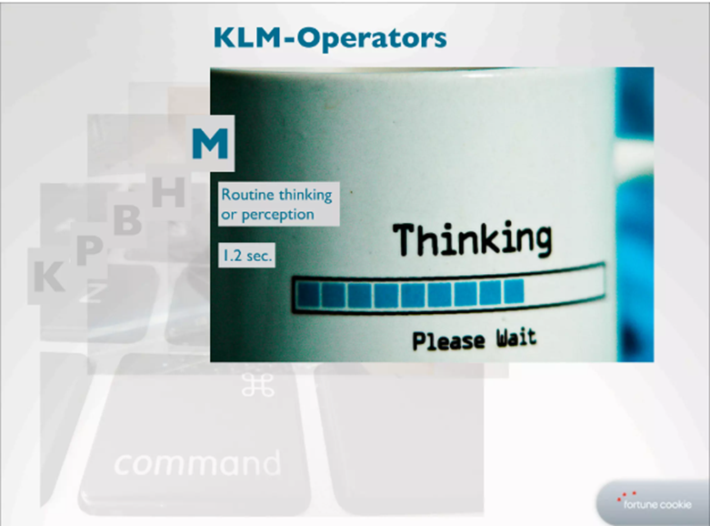
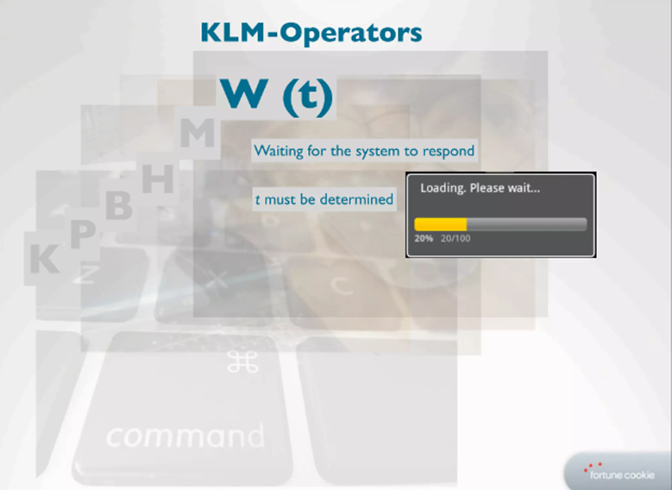
KLM Operator
Gpoup - 23
Page - 6

Slide 7
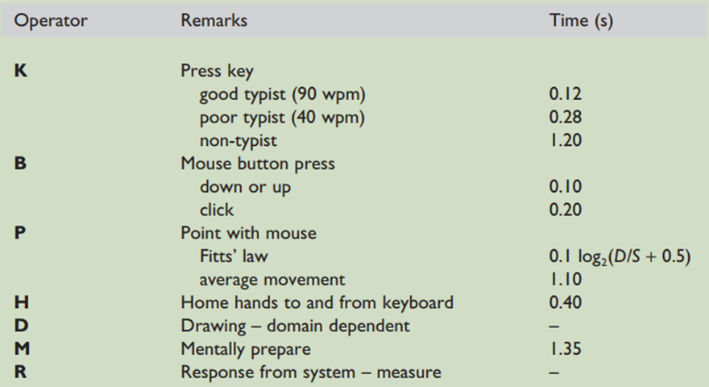
Time For Operations
Gpoup - 23
Page - 7

Slide 8
KLM Example
Question: Do a keystroke-level analysis for opening up an application in a visual desktop interface using a mouse as the pointing device, comparing at least two different methods for performing the Task.
Gpoup - 23
Page - 8

Slide 9
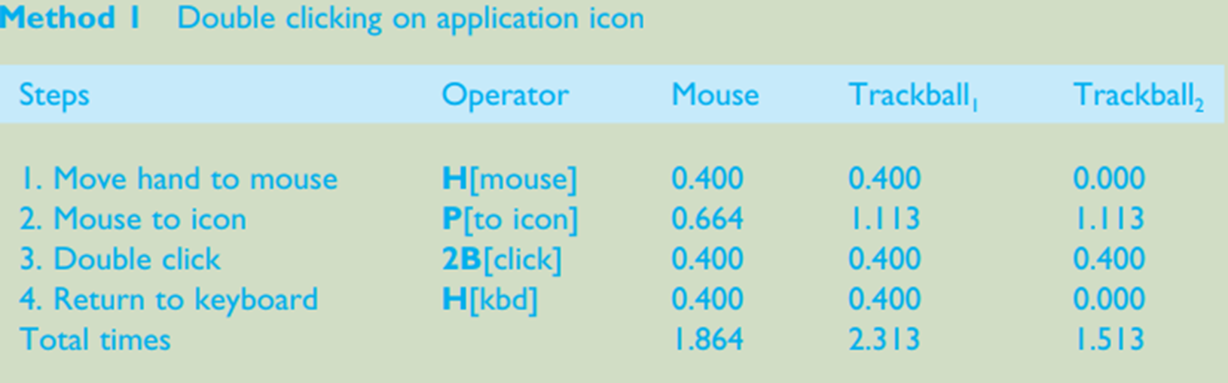
Method 1
Gpoup - 23
Page - 9

Slide 10
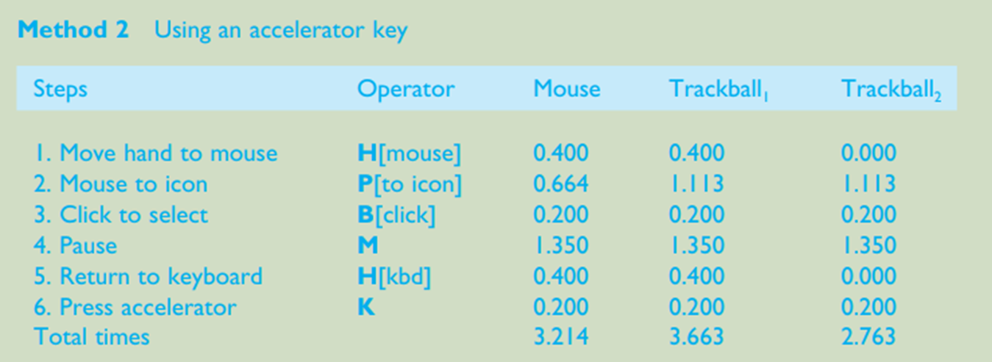
Method 2
Gpoup - 23
Page - 10

Slide 11
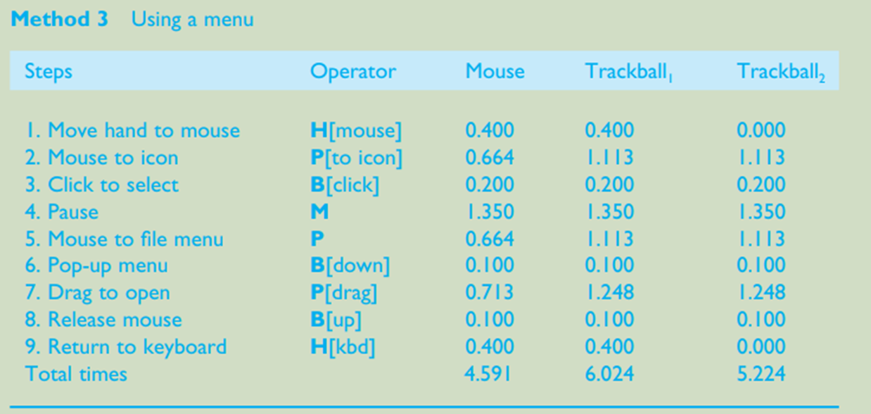
Method 3
Gpoup - 23
Page - 11

Slide 12
Summery
Card, Moran and Newell empirically validated KLM against a range of systems, both keyboard and mouse-based, and a wide selection of tasks. The predictions were found to be remarkably accurate. KLM is thus one of the few models capable of giving accurate quantitative predictions about performance.
However, the range of applications is correspondingly small. It tells us a lot about the micro-interaction but not about the larger-scale dialogue.
Gpoup - 23
Page - 12

Slide 13

Three State Model
STATE-1
STATE-2
STATE-0
Moving mouse with no buttons pressed
Depressing button over an icon & then moving the mouse.
This is for light pen when it is not touching screen or out of range
Gpoup - 23
Page - 13

Slide 14
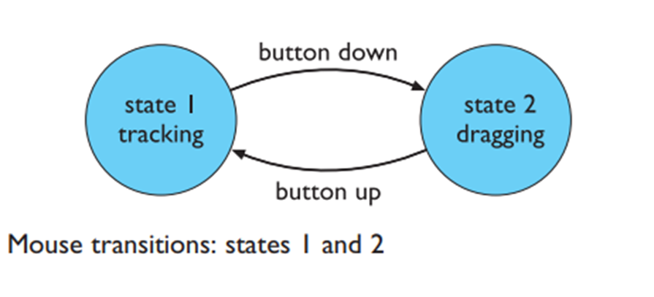
State 1 and 2
Buxton has developed a simple model of input devices, the three-state model, which captures some of these crucial distinctions. He begins by looking at a mouse.
If you move it with no buttons pushed, it normally moves the mouse cursor about.
This tracking behaviour is termed state 1. Depressing a button over an icon and then moving the mouse will often result in an object being dragged about. This he calls state 2.
Gpoup - 23
Page - 14

Slide 15
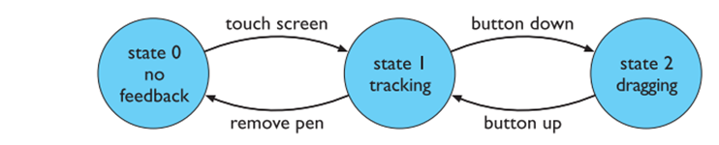
State 0
If instead we consider a light pen with a button, it behaves just like a mouse when it is touching the screen. When its button is not depressed, it is in state 1, and when its button is down, state 2.
However, the light pen has a third state, when the light pen is not touching the screen. In this state the system cannot track the light pen’s position. This is called state 0.
Figure 12.2 Light pen transitions: three states
Gpoup - 23
Page - 15

Slide 16
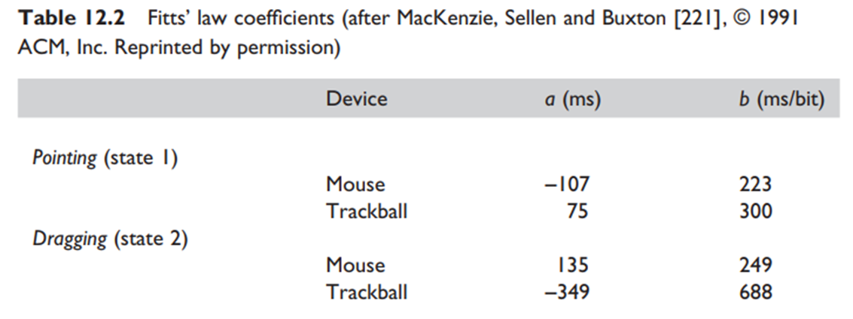
Fitt's Law
Fitts’ law says that the time taken to move to a target of size S at a distance D is:
= a+b log_2⁡(D/S+1)
The constants a and b depend on the particular pointing device used and the skill of
the user with that device.
Gpoup - 23
Page - 16

Slide 17
Three State Example
We can recalculate the KLM prediction for the CLOSE-METHOD using these data. Recall that the method had two pointing operators, one to point to the window’s title bar (with a distance to target size ratio of 10:1), the second to drag the selection down to ‘CLOSE’ on the pop-up menu (4:1). Thus the ﬁrst pointing operator is state 1 and the second is state 2. The times are thus
Mouse
P[to menu bar] =−107 + 223 log2(11) = 664 ms
P[to option] = 135 + 249 log2(5) = 713 ms
Trackball
P[to menu bar] = 75 + 300 log2(11) = 1113 ms
P[to option] =−349 + 688 log2(5) = 1248 ms
Gpoup - 23
Page - 17

Slide 18
Any Questions?
Gpoup - 23
Page - 18

